Slide 1


A wind tunnel for kids…
Status Update
February 23, 2012

Slide 2
Activities this week
SDD updated and submitted via Angel
Android development
Implemented initial capability providing control for 1 device from Android tablet
Began development on trend plotting tools
Generated Javadoc developer documentation
Project design discussions/documentation

Slide 3
Baseline Documentation Metrics
Metric | Value | Notes
# Developer Documents | 116 | SoW, SDP, SRS, SDD, Fall FQT, Javadocs
# Administrator Documents | 0
# Pages | 47
# Status Presentation Slides | 101

Slide 4
Baseline Code Metrics
Metric | Value | Notes
SLOC (Physical) | 9574
SLOC (Logical) | 7025
# Source Files | 107 | File types included: .h, .cpp, .java, .xml, .pde, .ino

Slide 5
Baseline Hardware Metrics
Metric | Value | Notes
# Sensors Prototyped | 3 | Temperature, Humidity, Hall Effect
# Control Elements Prototyped | 2 | Motor Control, LED
# Sensors Integrated | 1 | Hall Effect
# Control Elements Integrated | 1 | Motor Control

Slide 6
Arduino Communication Interface
http://youtu.be/xGlastBgfSE
LED is controlled by Android tablet using Wi-Fi and the HTTP-based communication interface we developed

Slide 7
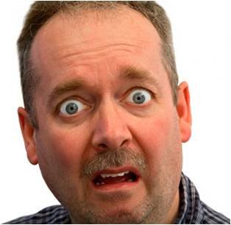

Follow us on Twitter… 7 followers – 47 tweets
@TunnelK
Notes:
Initial social network of choice…

